Slide 1
M & M Events
Our Services

Slide 2
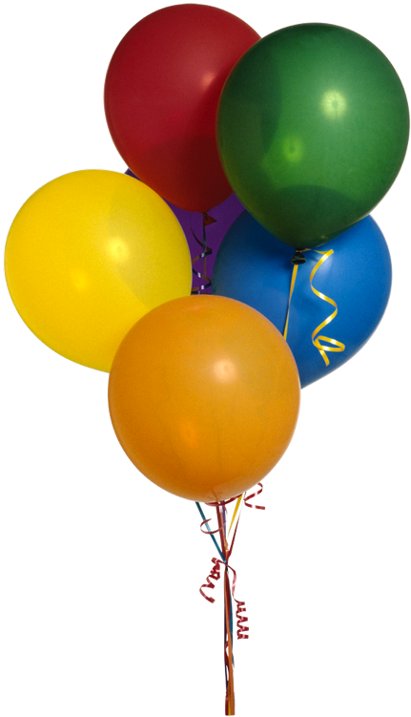
Birthdays
You’re never too young or too old to have a birthday party. Let us help you plan it.
Invitations
Food
Cake
Goodie Bags

