Slide 1
M & M Events

Slide 2
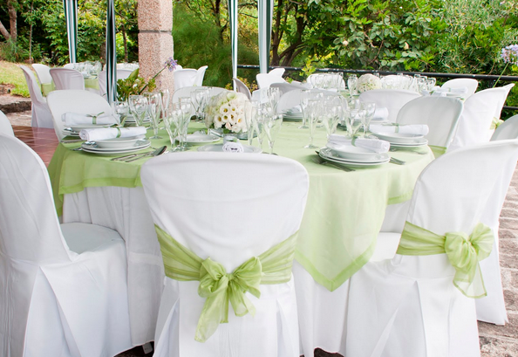
Décor and Event Setup
From tables and tents to flowers and forks we can provide everything you need to host the perfect affair.

