Slide 1
Trends in Modernist Cuisine and the Inclusion of STEM Curricula in Culinary Arts Programs
Chef John Draz CEC, CCE
ACTE 2013
Las Vegas

Slide 2
Description
In recent years, fine-dining restaurants and world-class chefs have embraced technology and food science to create new and unique dishes and dining experiences. This trend places an unprecedented importance on science in the kitchen and can be used as an effective motivator for culinary students in their science and math studies. This session looks at three food preparation techniques popularized by this trend, their underlying science, and how they relate to topics in STEM curricula.

Slide 3
Outcome
Through this presentation, culinary instructors will gain new insight into the importance of science and technology in contemporary fine dining. They will learn which scientific principles are the basis for important modernist culinary techniques and how to connect them to science and math curriculum.

Slide 4
John Draz CEC, CCE
15+ years teaching culinary arts
Founding program chair, The Culinary School of Kendall College
Co-author, The Culinary Professional
© 2014, Goodheart-Willcox Publisher
Currently, Research Chef, Ed Miniat, Inc.
Board Member, Research Chefs Assoc.

Slide 5
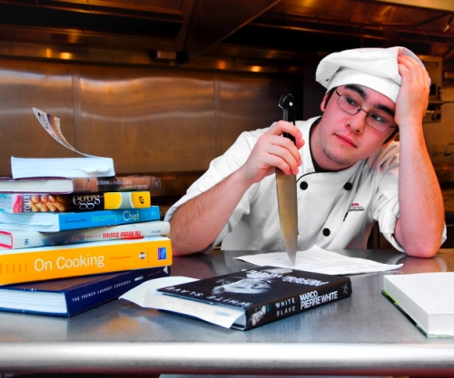
Connections
Integrating STEM
Relevance
New Career Paths
“ But I just want to cook”!

Slide 6
What is Modernist Cuisine?
A modern style of cooking, which takes advantage of many technical innovations from the scientific disciplines.
AKA
Molecular gastronomy
Culinary physics
Experimental cuisine
Culinology®

Slide 7
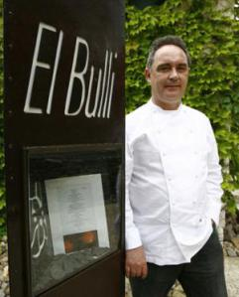
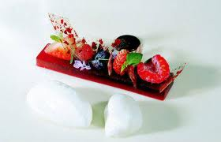
Pioneers of Modernist Cuisine
Ferran Adria
El Bulli,
Roses, Spain
1983- 2011
“The father of molecular gastromony”

Slide 8
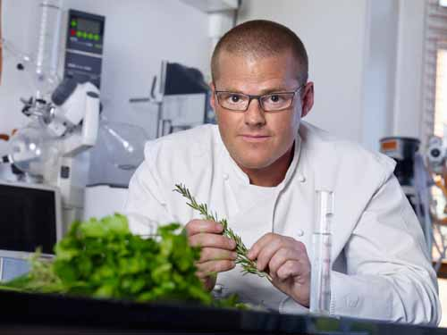
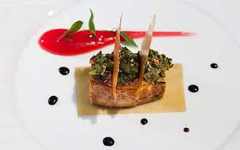
Pioneers of Modernist Cuisine
Heston Blumenthal
The Fat Duck
Bray, England

Slide 9
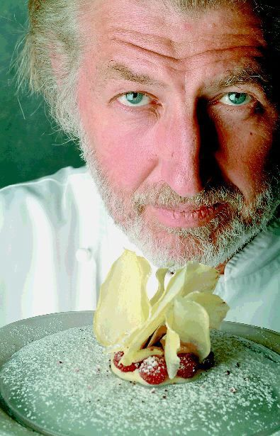
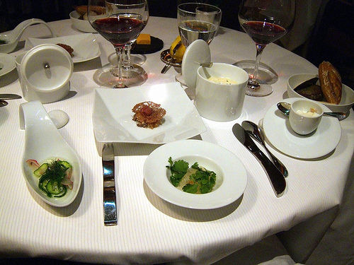
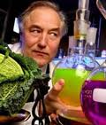
Pioneers of Modernist Cuisine
Pierre Gagnaire
Paris, France
Collaborates with
chemist Herve This

Slide 10
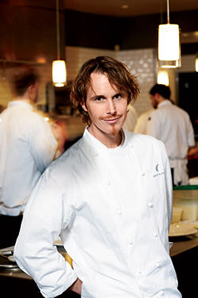
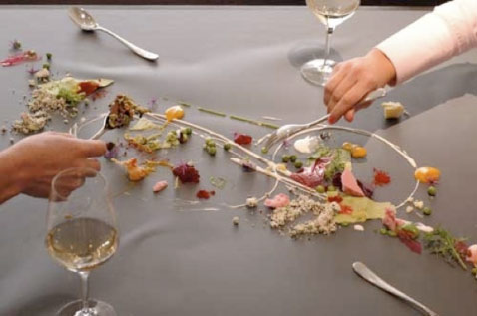
Pioneers of Modernist Cuisine
Grant Achatz
Alinea
Chicago

Slide 11
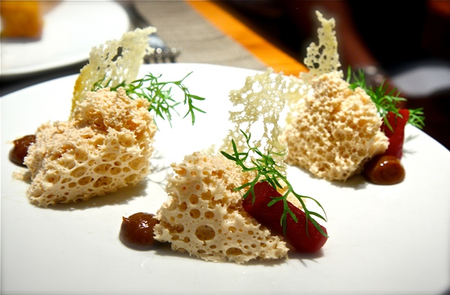
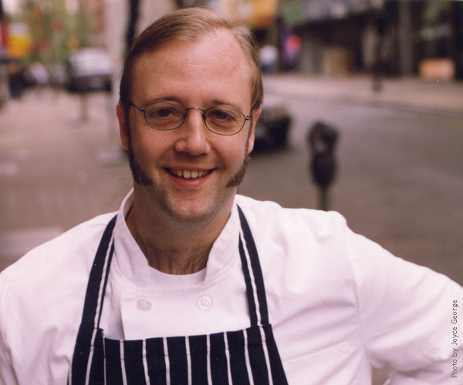
Pioneers of Modernist Cuisine
Wylie Dufresne
WD-50
New York

Slide 12
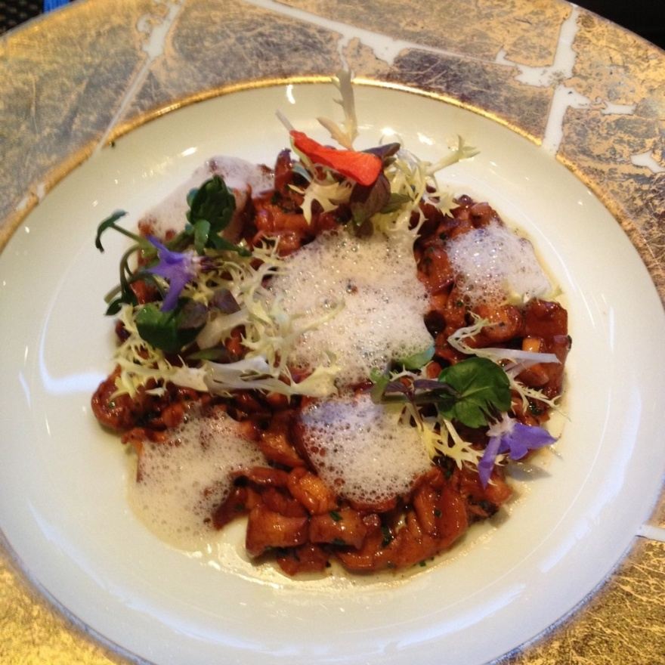
Modernist Technique 1 Culinary Foams
Foams are virtually a new form of sauce. Used as a complement to the main ingredient in appetizers, main courses and desserts, they deliver flavor with a unique texture. Foams deliver a dynamic contrast turning from light solid to liquid on the palate.

Slide 13
Modernist Technique 1 Culinary Foams
There are many forms of foam in the professional kitchen:
Mechanically produced – meringue, whipped cream.
Chemical reaction- baking soda, powder
Biologically produced- bread, beer
Charged with pressurized gas

Slide 14
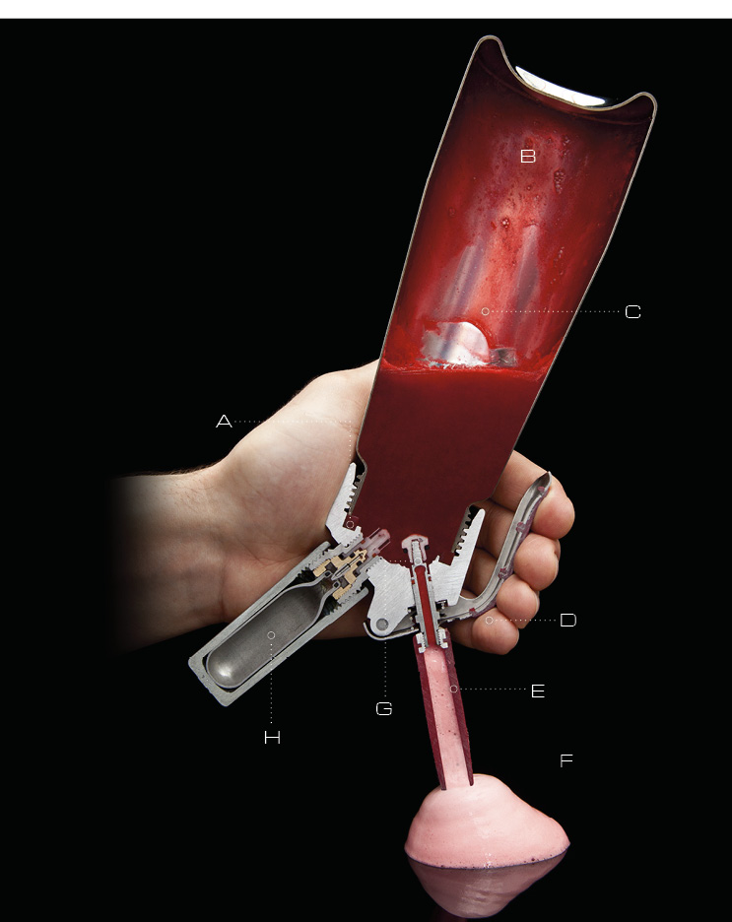
Creating Foam with a Charging Siphon CO₂ - carbonation NO₂ – fatty Ingredients
Modernist Cuisine

Slide 15
Charged Foams STEM Connections
Physics
gases and atmospheric pressure.
density / viscosity of liquid being foamed
Chemistry
protein and fat content of liquid being foamed
Engineering
understanding equipment used for charging
Math
formulation percentages

Slide 16
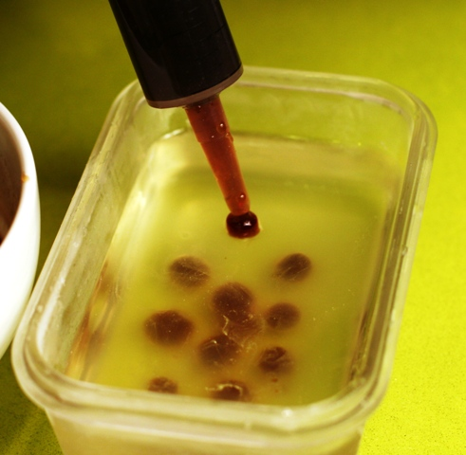
Modernist Technique 2 Spherification
Gelling reaction of calcium chloride and alginate
Calcium chloride blended with flavored liquid
Deposited in an alginate solution
Gel forms on the surface of the droplet encapsulating the flavored liquid
Reverse process also used

Slide 17
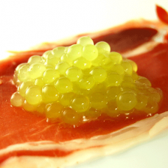
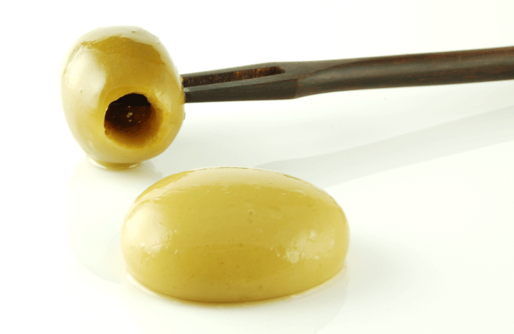
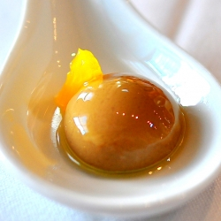
Modernist Technique 2 Spherification
Size of droplets can create
Caviar
Olives
Liquid ravioli

Slide 18
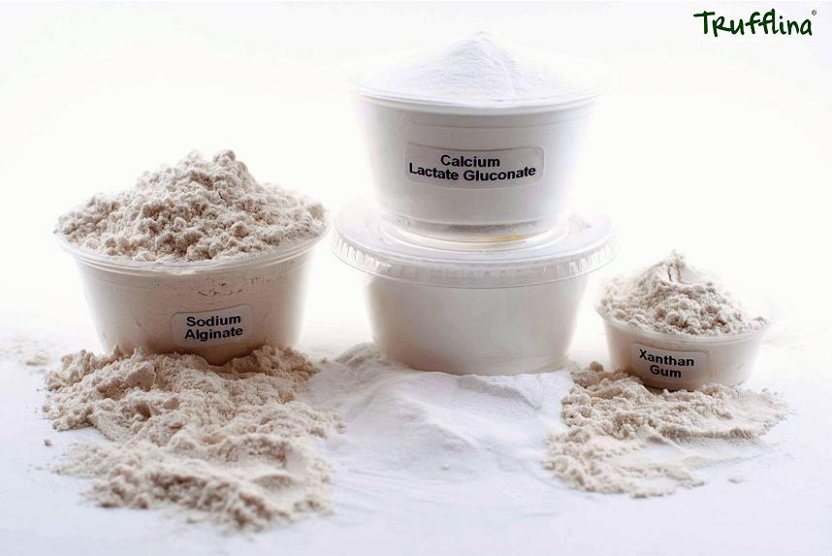
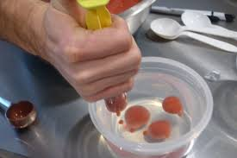
Spherification STEM Connections
Chemistry – reaction of calcium chloride and alginate (alginic acid) creates the gelatinous substance calcium alginate
CaCl₂
C₁₂H₁₄CaO₁₂
C₆H₈O₆
Physics
Hydraulics
Density of liquids
Technology – use of functional ingredients in the kitchen
Math – formulation percentages

Slide 19
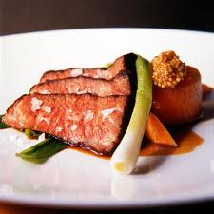
Modernist Technique 3 Sous Vide
Cooking foods in a vacuum bag in a water bath
Sous vide (pronounced Soo Veed) is French for “under vacuum”
Extremely accurate temperature temperature control
Capability of long cook cycles at low temperatures

Slide 20
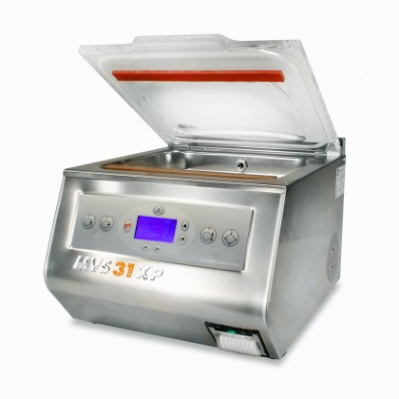
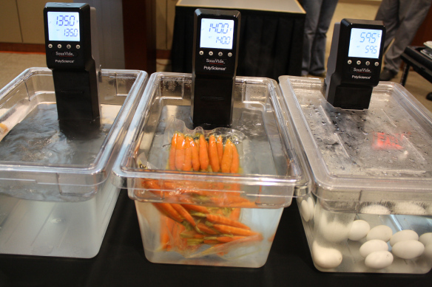
Modernist Technique 3 Sous Vide
Two Step Process
Vacuum Sealing
Water Bath Cooking

Slide 21
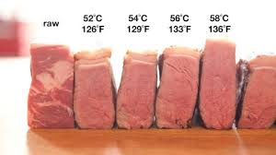
Modernist Technique 3 Sous Vide
Meat and Poultry
Low temperature = tenderization, moisture retention and even doneness
Searing used to enhance flavor and appearance

Slide 22
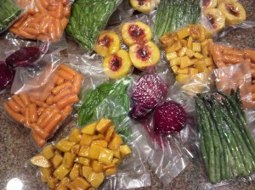
Modernist Technique 3 Sous Vide
Vegetables / Fruits
Delicate textures preserved.
Liquid used to infuse flavor.

Slide 23
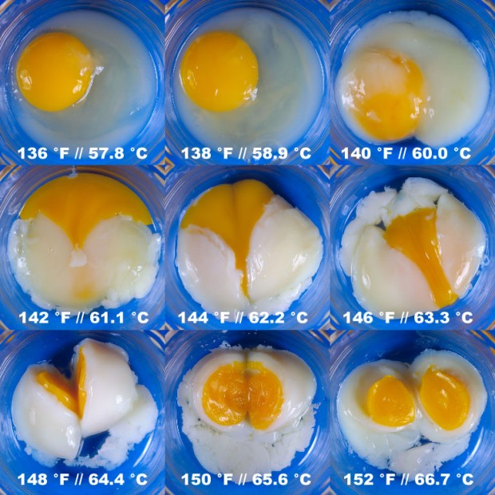
Modernist Technique 3 Sous Vide
Eggs
Exact temperatures produce many textures
Long holding times
possible

Slide 24
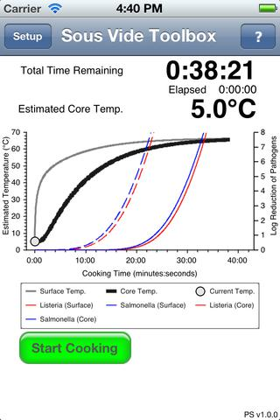
Sous Vide STEM Connections
Physics
Vacuum
Heat transfer
Biology
Pathogen control
Engineering/Technology
Vacuum
Cooking Equipment
Temperature monitoring
Math
Charting Cook Cycles

Slide 25
Other Techniques
Freezing with liquid nitrogen
Anti-griddle
Dry ice carbonation
Vacuum distillation
Centrifuges
Smoke guns

Slide 26
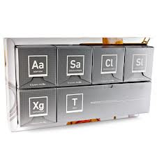
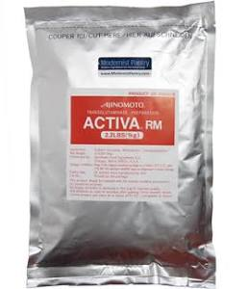
Other Ingredients
Hydrocolloids
Gums
Cold gel starches
Emulsifiers
Transglutaminase
“meat glue”
Flavor ingredients
Extracts
Oils

Slide 27
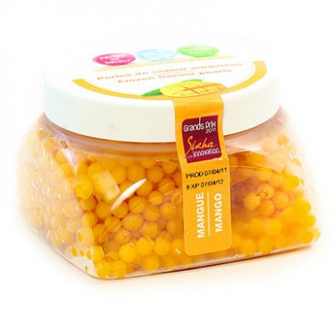
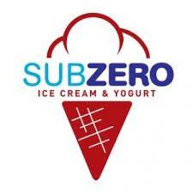
Modernist Goes Mainstream
Food Trucks featuring “MoGa”
Pre-made “Fruit Pearls”
Sous Vide in Fast Casual Restaurants
Chipotle Mexican Grill
Panera
Liquid Nitrogen Ice Cream chain

Slide 28
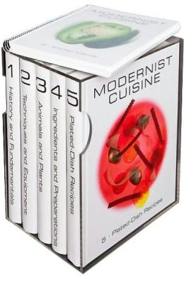
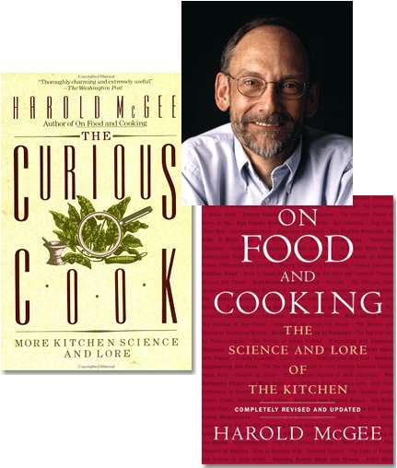
Resources - Print
Modernist Cuisine:The Art and Science of Cooking
by Nathan Myhrvold, Chris Young, Maxime Bilet
Modernist Cuisine at Home
On Food and Cooking: The Science and Lore of the Kitchen
by Harold McGee
The Curious Cook

Slide 29
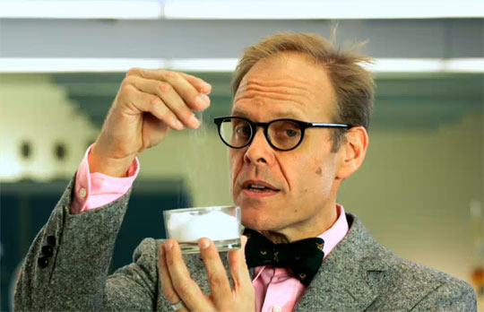
Resources - Media
Good Eats
Alton Brown
Food Network
Fine Cooking
http://www.finecooking.com/blog/food-geek
Modernist Cuisine Made Easy
http://www.modernistcookingmadeeasy.com/
Science of Cooking
http://www.scienceofcooking.com/
Serious Eats
The Food Lab
http://www.seriouseats.com/the-food-lab/
Youtube – “molecular gastronomy” = 36,700

Slide 30
Resources - Organizations
Research Chefs Association
Approved Culinology® Programs
http://www.culinology.com
Institute of Food Technologists Student Association
Scholarships
http://www.ift.org/community/students/about-iftsa.aspx

Slide 31
?
Questions
Comments
Anecdotes
Observations

Slide 32
Thank You !

