Slide 1
Connecting Culinary Arts with STEM
John Draz CEC, CCE
ACTE 2013
Las Vegas

Slide 2
John Draz CEC, CCE
15+ years teaching culinary arts
Founding program chair, The Culinary School of Kendall College
Co-author, The Culinary Professional
  © 2014, Goodheart-Willcox Publisher
Currently, Research Chef, Ed Miniat, Inc.
  Board Member, Research Chefs Assoc.

Slide 3
Description
In recent years, fine-dining restaurants and world-class chefs have embraced technology and food science to create new and unique dishes and dining experiences. This trend places an unprecedented importance on science in the kitchen and can be used as an effective motivator for culinary students in their science and math studies. This session explores ways in which secondary level culinary arts and foods instructors can highlight the importance of STEM and its practical application to their students.

Slide 4

Connections
Integrating STEM
Relevance
New Career Paths
“ But I just want to cook”!

Slide 5
Relevance
Science Has Never Been More Important in the Professional Kitchen
The basis of culinary education is understanding processes and reactions
  Apprenticeship vs. formal training
  Focus on Culinary Science in post secondary programs

Slide 6
Relevance
Modernist Cuisine
A modern style of cooking, which takes advantage of many technical innovations from the scientific disciplines.
AKA
  Molecular gastronomy
  Culinary physics
  Experimental cuisine
  Culinology®

Slide 7

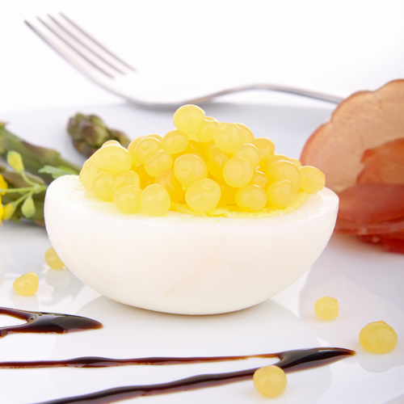
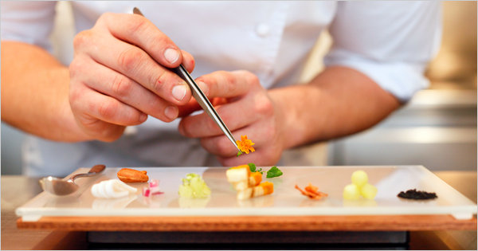
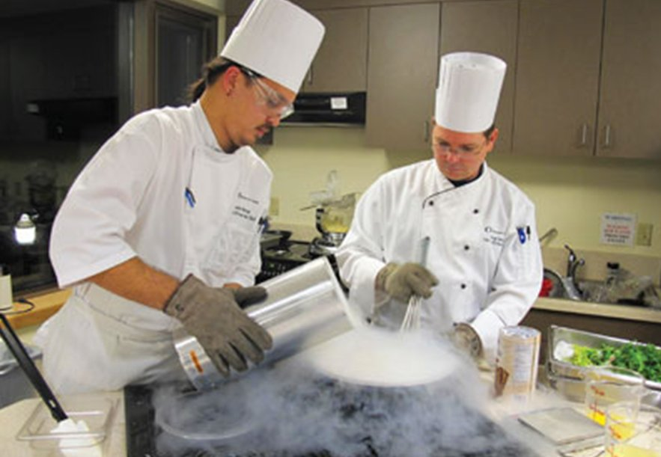
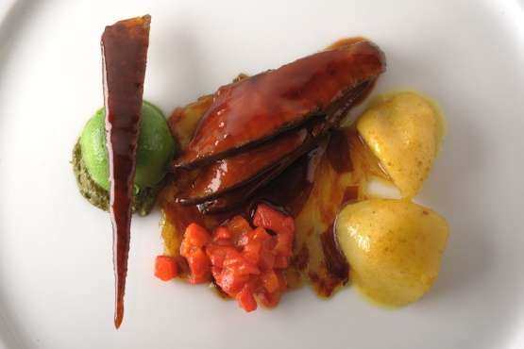

Slide 8

Relevance - Science
Chemistry
Nutrient content
Cooking Reactions
Flavor Compounds
Biology
Pathogens
Fermentation
Physics
Heat Transfer

Slide 9

Relevance – Technology & Engineering
Cooking Technology
Temperature monitoring
Food Preservation
Nutrient Analysis
Business management systems
Promotions and marketing media

Slide 10

Relevance - Math
Fractions and Percentages
Units of Measure
Scaling
Formulas
Conversion
Geometry
Food presentation
Algebra
Forecasting
Graphing
Cook cycles
HACCP

Slide 11
Recipe Development follows the Scientific Method
Question / Hypothesis / Prediction
  Reason for creating a new recipe
Testing – multiple iterations with a single variable.
Analysis – Taste paneling
Replication – Standardized recipe
External Review – Recipe sharing

Slide 12
New Career Paths for Culinarians that Embrace Science
Educator
Dietitian
Research Chef (CRC)
Food Scientist (CCS)

Slide 13
The Culinary Professional
2nd Edition
New Section Introductions that highlight Science in the kitchen
Expanded Sidebars
  Science and Technology
  Mix in Math

Slide 20
?
Questions
Comments
Anecdotes
Observations

Slide 21
Thank You !

